Slide 1
In-Memory Computing for Big Data
Pravin Y Pawar

Slide 2
Hadoop for Big Data
Issues with MapReduce on Hadoop
Apache Hadoop
Revolutionized big data processing, enabling users to store and process huge amounts of data at very low costs.
An ideal platform to implement complex batch applications as diverse as
sifting through system logs
running ETL
computing web indexes
recommendation systems etc.
Its reliance on persistent storage to provide fault tolerance and its one-pass computation model make MapReduce a poor fit for
low-latency applications
iterative computations, such as machine learning and graph algorithms.
Adapted from : https://databricks.com/blog/2013/11/21/putting-spark-to-use.html

Slide 3
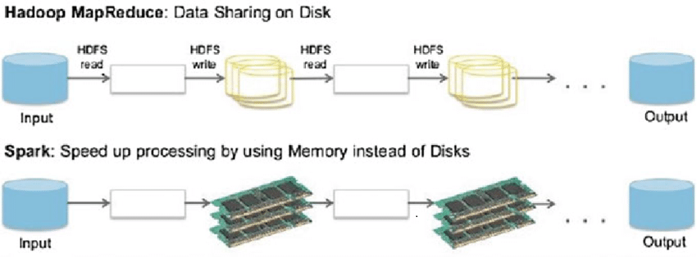
In-Memory Computing
In-memory computing
means using a type of middleware software that allows one to store data in RAM, across a cluster of computers, and process it in parallel
For example,
Operational datasets typically stored in a centralized database which you can now store in “connected” RAM across multiple computers.
RAM is roughly 5,000 times faster than traditional spinning disk.
Add to the mix native support for parallel processing, and things get very fast. Really, really, fast!
RAM storage and
parallel distributed processing
are two fundamental pillars of
in-memory computing.

Slide 4
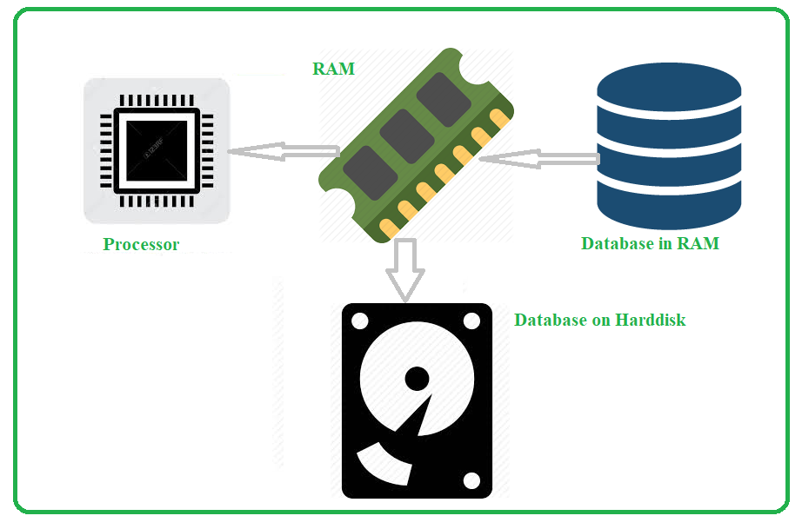
In-Memory Computing for Big Data
RAM (or primary storage area)
is used for data processing
Helps to increase the computing speed
Reduction in prices made is affordable
Data handling
Relational databases are used for structured data
Unstructured data is handled by NoSql databases
Volume is addressed by IMC
Diversity of big data managed by NoSQL databases

Slide 5
Fast and Easy Big Data Processing with Spark
At its core, Spark provides a general programming model that enables developers to write application by composing arbitrary operators, such as
mappers
reducers
joins
group-bys
and filters
This composition makes it easy to express a wide array of computations, including iterative machine learning, streaming, complex queries, and batch.
Spark keeps track of the data that each of the operators produces, and enables applications to reliably store this data in memory.
This is the key to Spark’s performance, as it allows applications to avoid costly disk accesses.

Slide 6
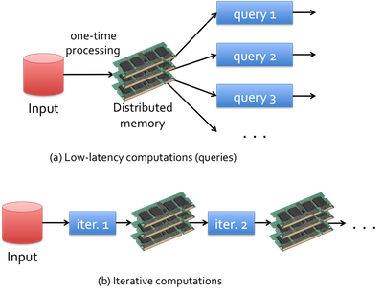
Apache Spark Applications
Spark enables
Low-latency computations
by caching the working dataset in memory and then performing computations at memory speeds
Efficient iterative algorithm
by having subsequent iterations share data through memory, or repeatedly accessing the same dataset

Slide 7
Thank You!
In next lecture : Big Data Analytics Lifecycle

